Slide 1

Notes:
Because we would like to make a meaningful contribution to our world we launched our frim commitment for this effort.
Scouts for SDGs mobilization.

Slide 2
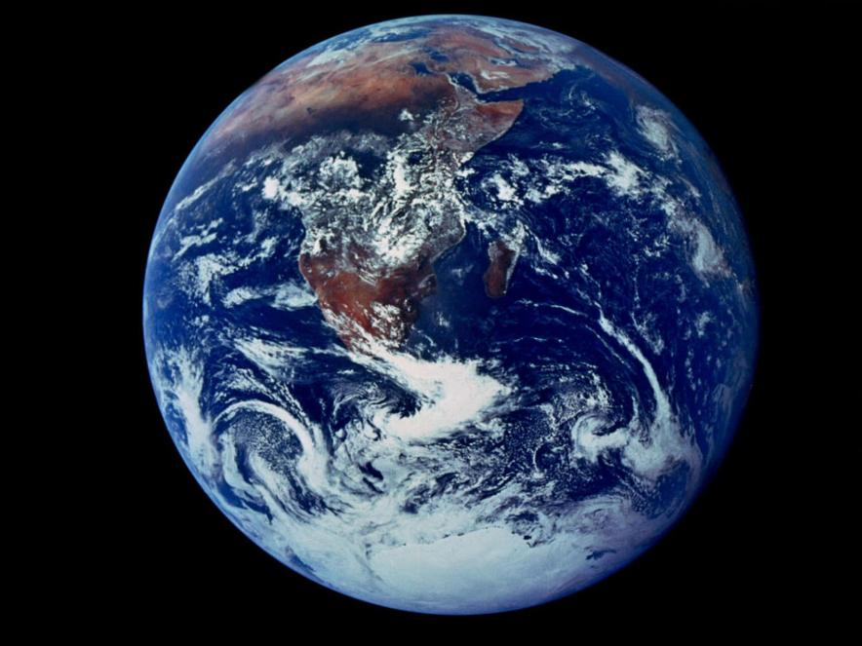

Blue Marble, 1972
Notes:
This famous "Blue Marble" shot represents the first photograph in which Earth is in full view. The picture was taken on December 7, 1972, as the Apollo 17 crew left Earth’s orbit for the moon. With the sun at their backs, the crew had a perfectly lit view of the blue planet.

Slide 3
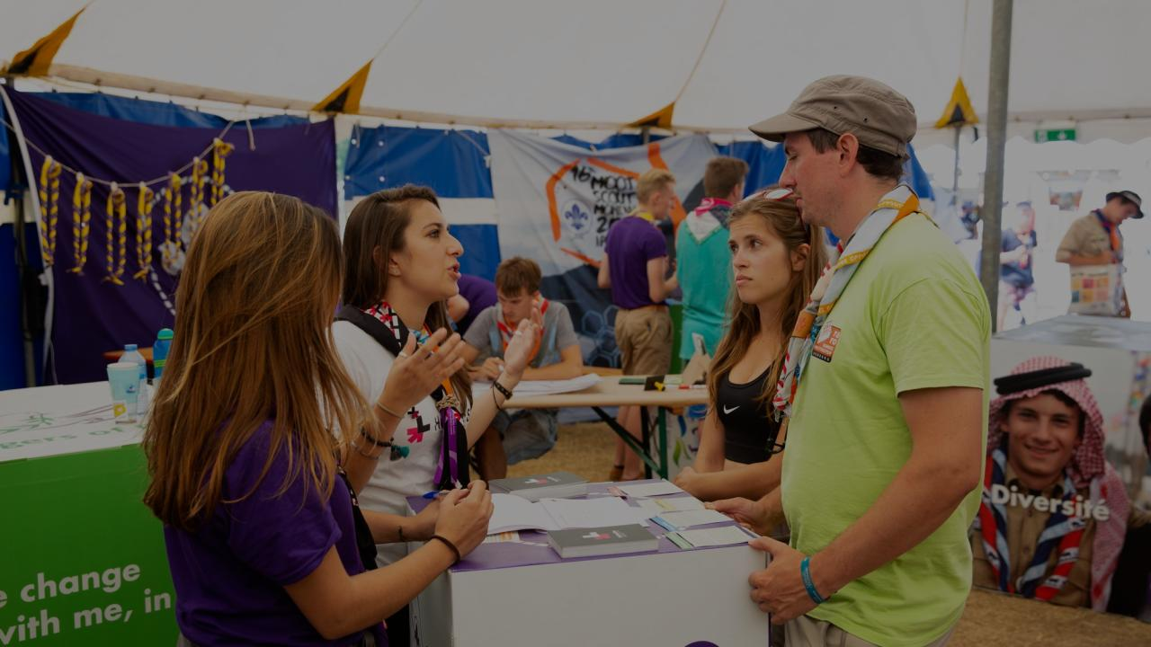
Please share one word to describe our planet in 2030

Slide 4
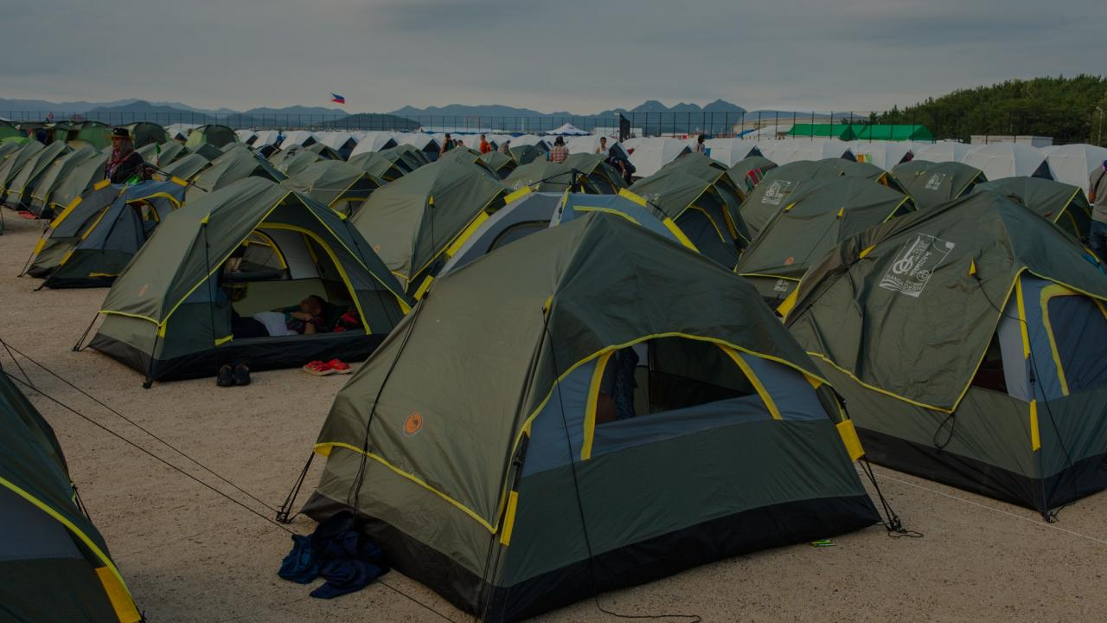
What are Scouts doing to create a sustainable world by 2030?

Slide 5
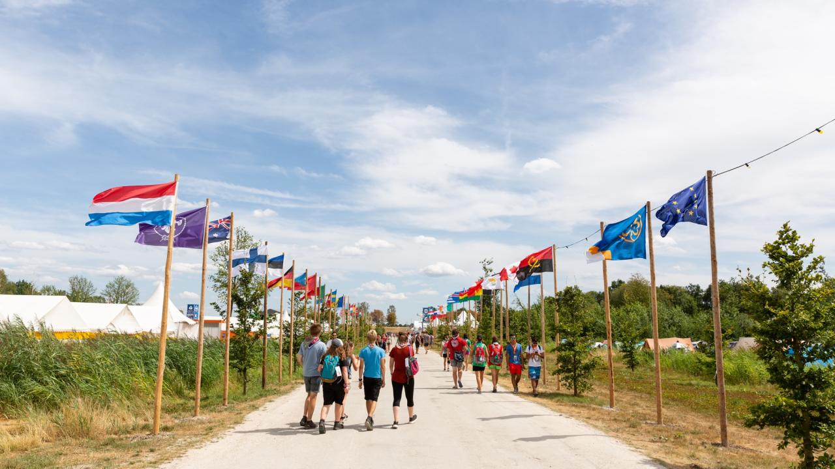

Notes:
Our Movement has the privilege to inspire 50 million Scouts and billions of people have gone through the movement. Then can also be inspired to make a greater impact for sustainability.

Slide 6
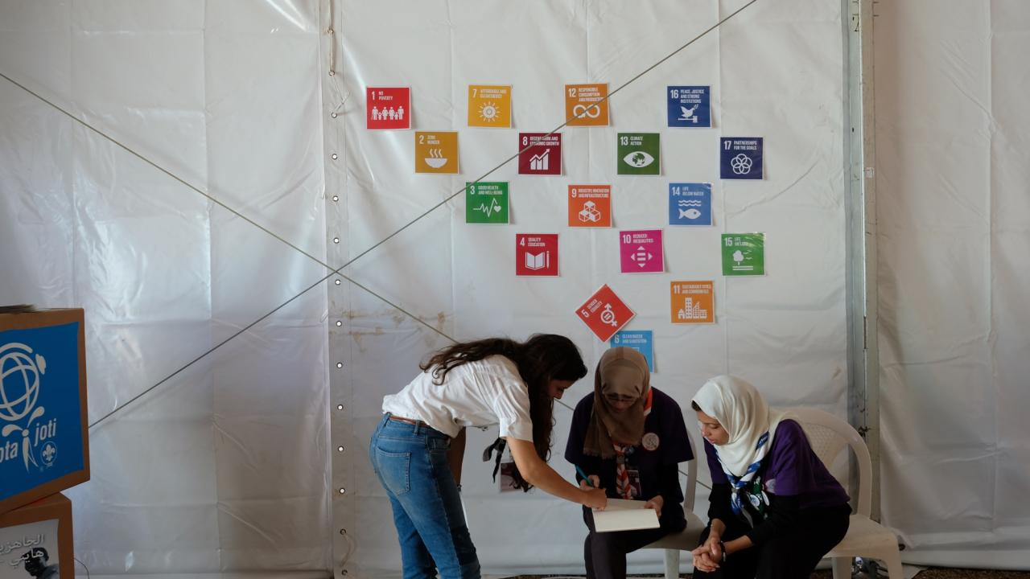
What is
Scouts for SDGs?
Notes:
We have 111 years of history behind brining positive change to our communities.

Slide 7
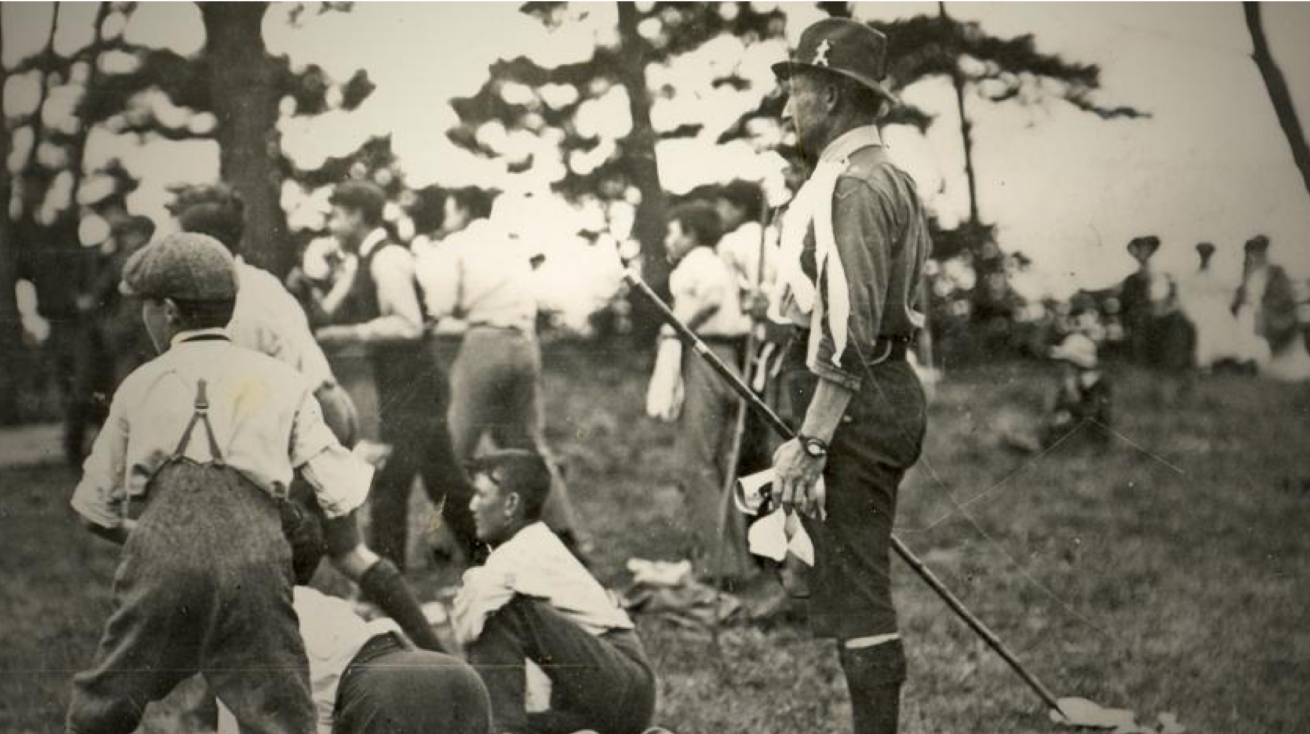




Notes:
Do you identify this moment in the history of Scouting? It’s the first camp organized by BP. For the first experimental camp he brought together young boys from different backgrounds, to teach them and practice new useful skills for life in the outdoors.
If we match his action today in light with the SDGs, what of the SDGs do you think he was contributing to?
What would you say about BP contributing to SDG4, SDG10, SDG11 and SDG16 with one single project?

Slide 8
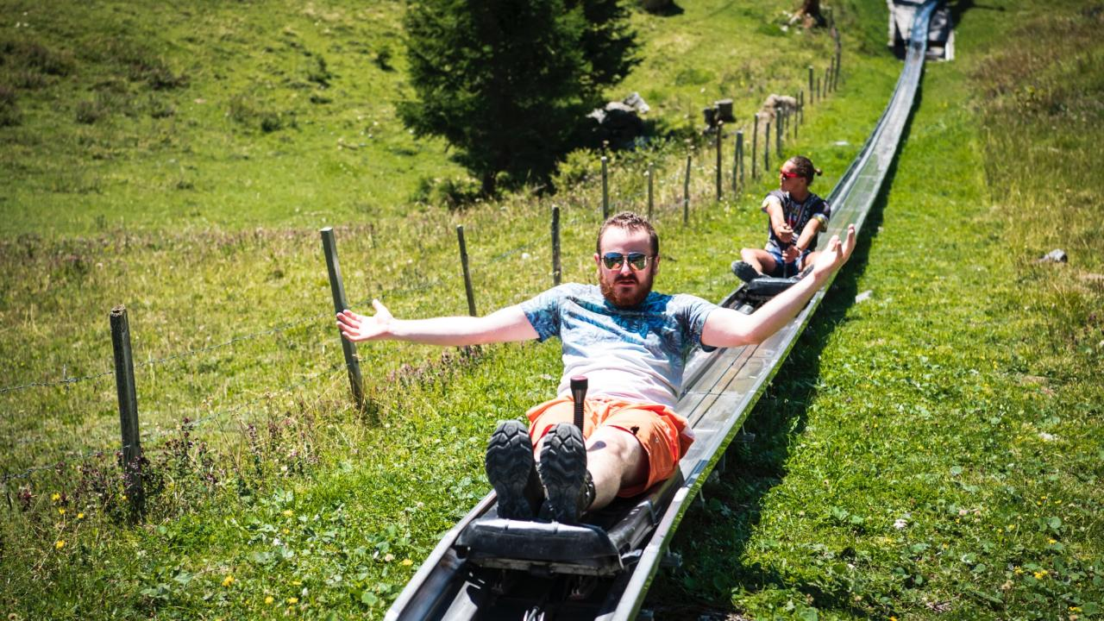

What is Scouts for SDGs?
Check out this video
Notes:
Scouts for SDGs is a Mobilisation of 50 million Scouts
that leverages the Scout Youth Programme and the Movement’s initiatives
under the Better World Framework, including the flagship Messengers of Peace initiative, to raise awareness and take action towards the
17 Sustainable Development Goals (SDGs).

Slide 9
Is a mobilisation of 50 million Scouts that leverages the Scout Youth Programme and the Movement’s initiatives under the Better World Framework, including the flagship Messengers of Peace initiative, to raise awareness and take action towards the
17 Sustainable Development Goals (SDGs).
What is Scouts for SDGs?
Notes:
Scouts for SDGs is a Mobilisation of 50 million Scouts
that leverages the Scout Youth Programme and the Movement’s initiatives
under the Better World Framework, including the flagship Messengers of Peace initiative, to raise awareness and take action towards the
17 Sustainable Development Goals (SDGs).

Slide 10
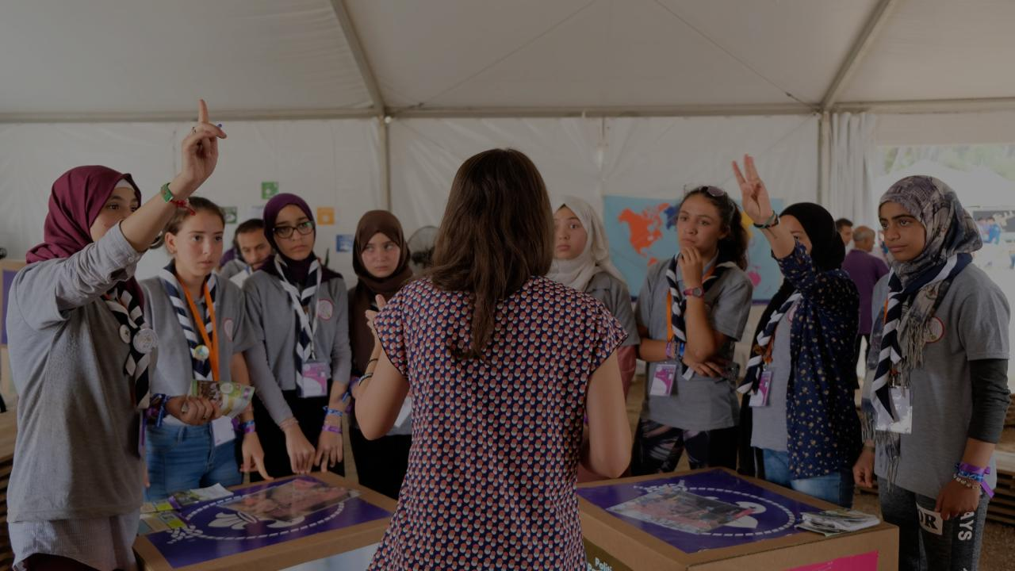
Scouting enables young people to be active global citizens.

Slide 11
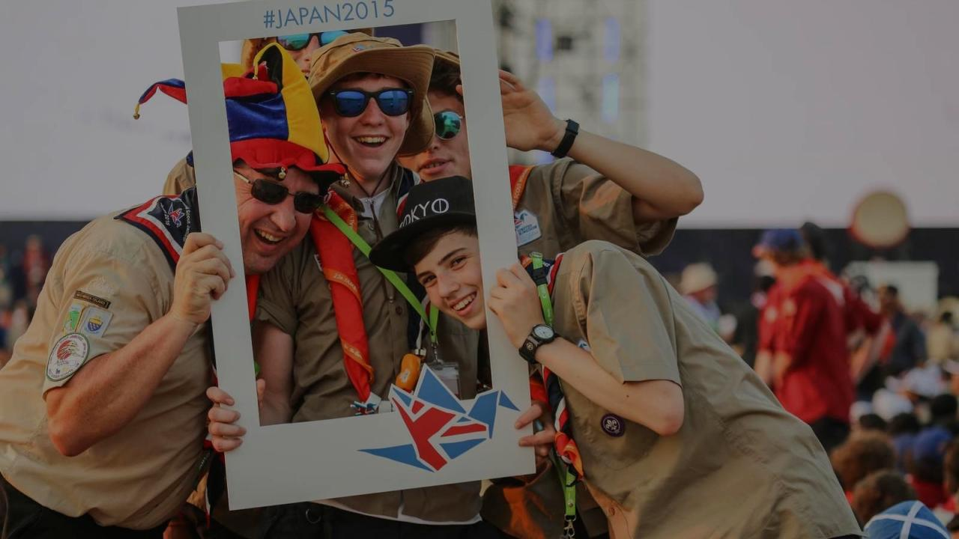
Education is key to the achievement of sustainable development.

Slide 12
How will Scouts
for SDGs work?
Inspire
Enable
Deliver
young people to become active global citizens by offering them education, training, and learning opportunities through Scouting to explore and advocate for sustainable development.
Young people with the tools and information to develop key sustainable development competencies, while also building the capacity of National Scout Organizations (NSOs) to offer quality non-formal educational experiences to 50 million Scouts.
Young people with competencies for the SDGs that create local actions connected to the SDGs through community service and development projects that are implemented as part of the Scout Youth Programme and Scout initiatives within the Better World Framework.
Notes:
This is for discussion with the group.

Slide 13
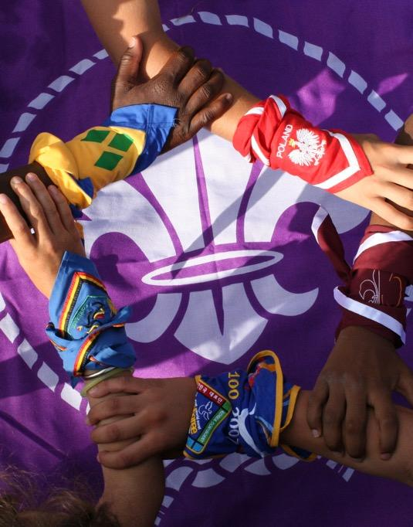
The Scout Movement is united to achieve the SDGs.

Slide 14
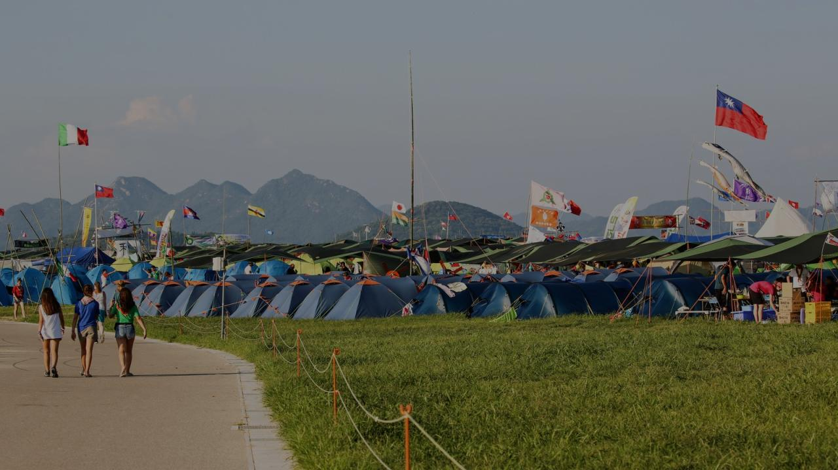
The Scout Movement’s contribution leading up to 2030 –
the world’s largest coordinated youth activation.
50
million
young people
2
Million local actions
related to the 17 Goals
+3
billion service hours for the SDGs

Slide 15
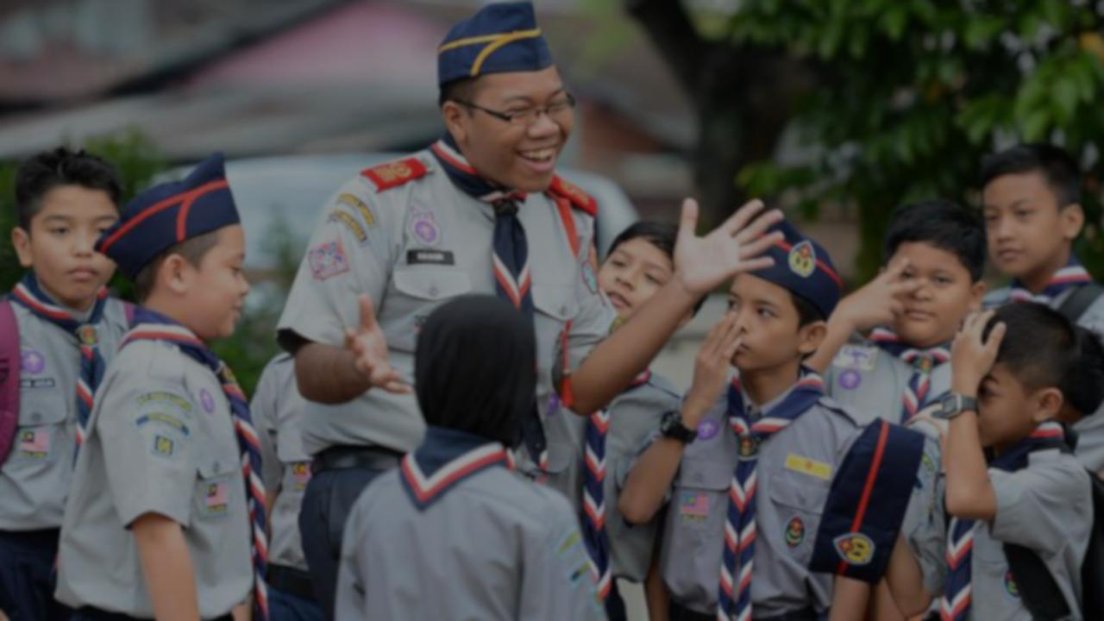


BY 2030…
...all Scouts acquire the key competencies to promote sustainable development.
Notes:
Sustainable development is commonly defined as “development that meets the needs of the present without compromising the ability of future generations to meet their own needs.” This was proposed in the Brundtland report.

Slide 16
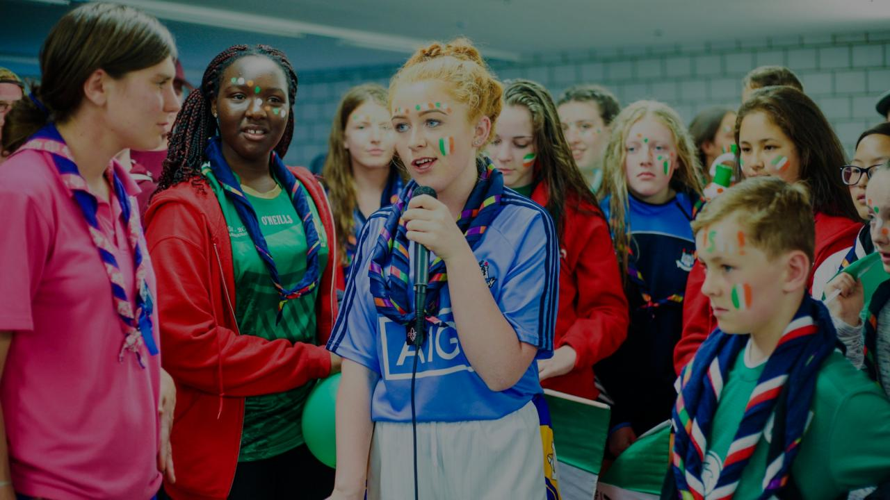

Why Scouting and SDGs?
Notes:
Sustainable development is commonly defined as “development that meets the needs of the present without compromising the ability of future generations to meet their own needs.” This was proposed in the Brundtland report.

Slide 17
Why Scouting and SDGs?
Inspire more young people by telling the story
Ensure Scouting’s continued relevance for society
Become more sustainable as an individual, making communities more resilient
Be part of the global agenda
Strengthen partnerships and improve fundraising
Notes:
By completing its purpose of creating active global citizens, Scouting contributes to achieving the SDGs. The opportunity here is to go further in strengthening the educational proposal of the Youth Programme when it comes to education for sustainable development. Aligning to the SDGs is an opportunity:
Continue inspiring young people to create a better world by showing them how their actions impact a bigger cause outside of Scouting;
Offer new learning opportunities to young people and equip them with the knowledge and skills they need to find lasting solutions to the issues that affect them most;
Reinforce the Youth programme by identifying and addressing gaps;
Ensure Scouting’s continued relevance by answering the current needs of young people;
Be part of the global agenda on sustainable development to help achieving the movement’s vision of being the leading educational youth movement on global citizenship;
Promote Scouting to new audiences by showcasing Scouting’s impact on sustainable development for over 110 years;
Strengthen partnerships and improve fundraising by being part of SDG 17, “partnerships for the SDGs”, and collaborating with the other actors that want to see the SDGs achieved
Become more sustainable as an institution by aligning with the SDGs across all the organisation’s spheres of work

Slide 18
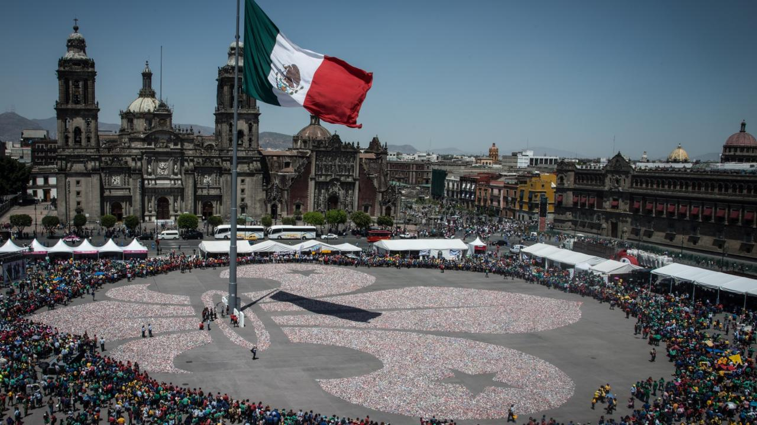
As part of the Scouts for SDGs mobilisation,
we will develop an enhanced monitoring and evaluation system for Scout initiatives under the
Better World Framework, combined with a dedicated online SDGs hub that will help track the Scout Movement’s contribution to the 17 Goals through the Youth Programme.

Slide 19












Slide 20

BETTER WORLD FRAMEWORK

Slide 21
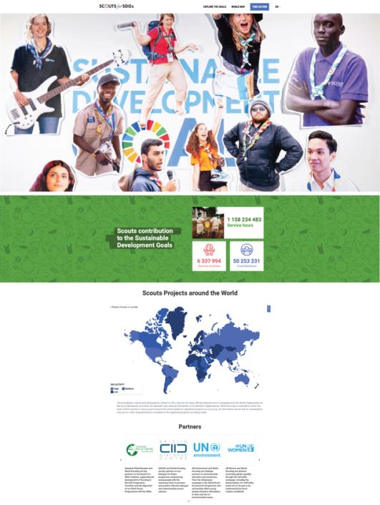
Click here to watch this video about the SDGs Hub
Notes:
https://sdgs.scout.org

Slide 22
SDGs HUB
sdgs.scout.org
Notes:
https://sdgs.scout.org

Slide 23








Our network of partnerships around the SDGs

Slide 24
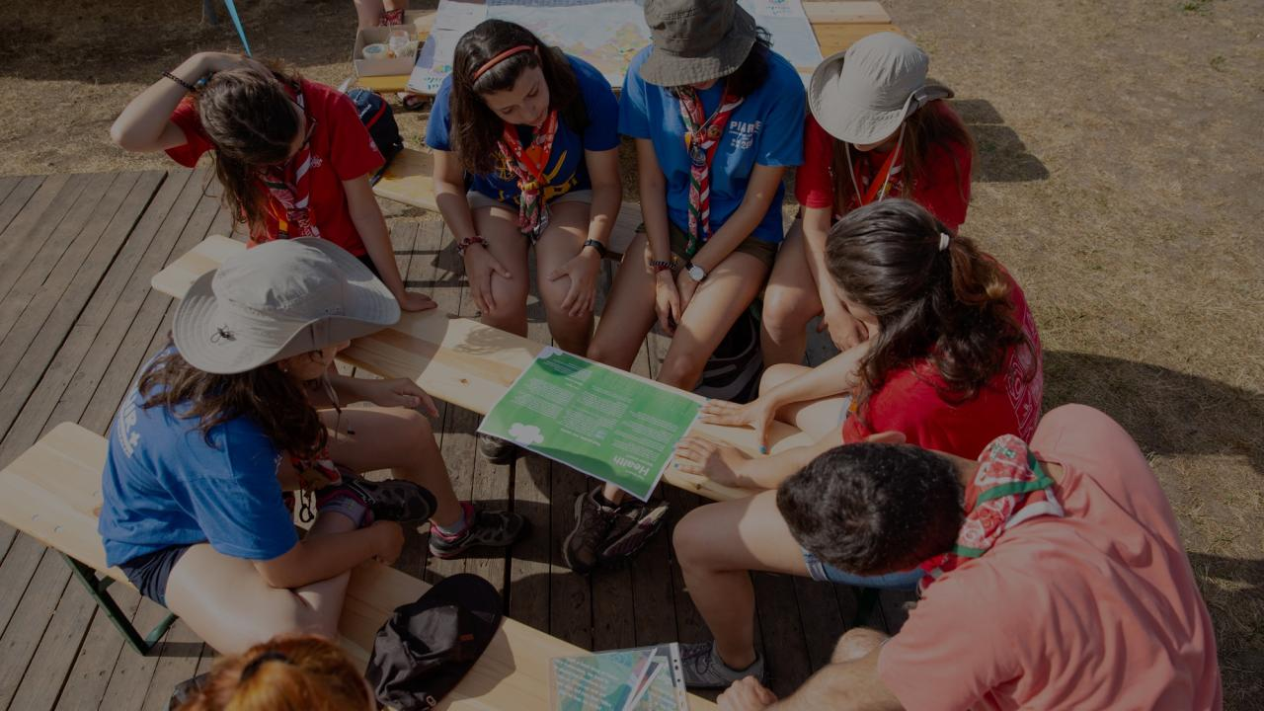
Scouts for SDGs launch at the United Nations
Adapt the Better World Framework initiatives to align with the SDGs
New online SDGs hub
Engage highly influential public figures (Bear Grylls)
Supporting the 170 NSOs to align through training and capacity-building at World and Regional levels
Some of the efforts we will carry out include:

Slide 25
Position young people as agents of change
Support young people to be peer-to-peer mentors
Develop a range of new online toolkits and campaigns
Some of the efforts we will carry out include:

Slide 26
#SCOUTS4SDGS
THANK YOU!

